Slide 1
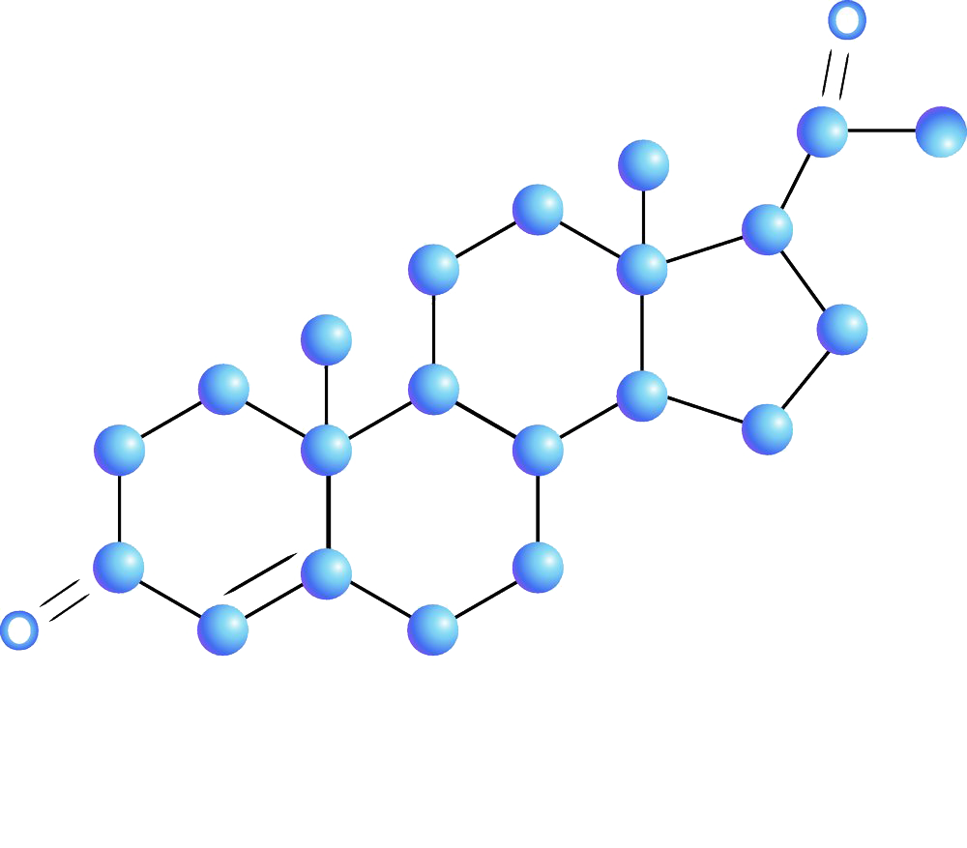

Neuropathic Pain
Client: ELENA VIKENTIEVNA ROMANOVA
Group 6: Yijin Wang, Ziyi Xue, Yongxin Cai, Jue Li
Date: 04/18/2023

Slide 2
Agenda
Intro Background(project goal, 4 test)
Data properties (correlation, Missing）
ANOVA principle
Check ANOVA Assumptions
ANOVA modeling process & test cases
Analysis result (each protein in group)
Conclusion
Difficulties & Improvement

Slide 3
Background
Neuropathic pain
Neuropathic pain typically triggered by an event or injury but by the body sending pain signals to the brain unprompted.
DRGS
DRGs are pain control centers in our body;

Slide 4
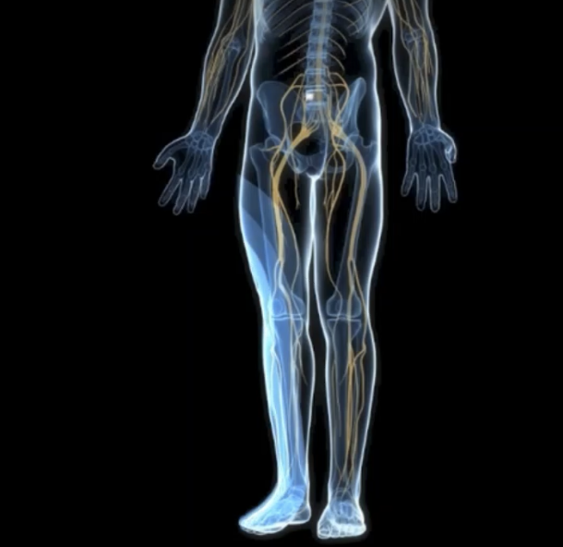
1.1 Test Goal
Test Goal: determine changes in peptides/proteins in DRGs associated with injury-induced pain and electrical stimulation treatment
Notes:
Dorsal Root Ganglia of Spinal Cord and Pain

Slide 5
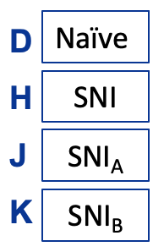
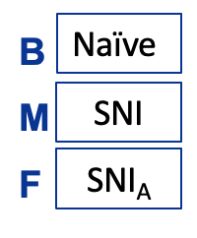
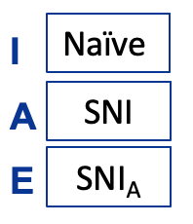
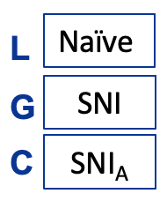
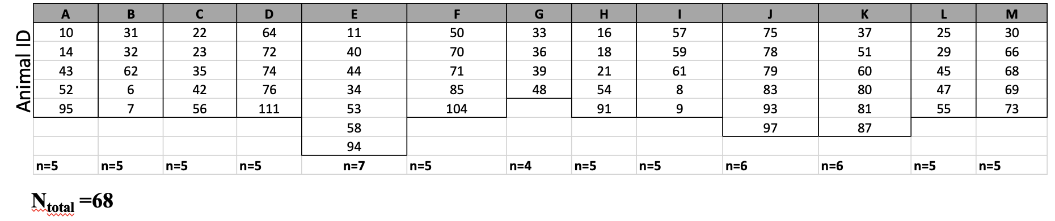
1.2 Data Collect
7 th day
21 st day
35 th day
56 th day

Slide 6
1.3 Objectives & Method
Same time Compare
D vs.H; B vs.M; I vs.A; L vs.G
H vs.J; M vs.F; A vs.E; G vs.C; K vs.E; K vs.C; K vs.E vs.C
D vs. H vs. J; B vs. M vs, F; I vs. A vs. E;
J vs. G vs. C vs. K
SNI different time compare
H vs.M vs.A vs.G
Method: Analysis of Variance - linear regression
Notes:
spared nerve injury

Slide 7
2 Dataset Introduction
3 csv: from three Group, Naïve, SNI, SNI1 & SNI2
Contain: 27 row of protein
59 mice as test ← remove missing value mice
Notes:
3 csv

Slide 8
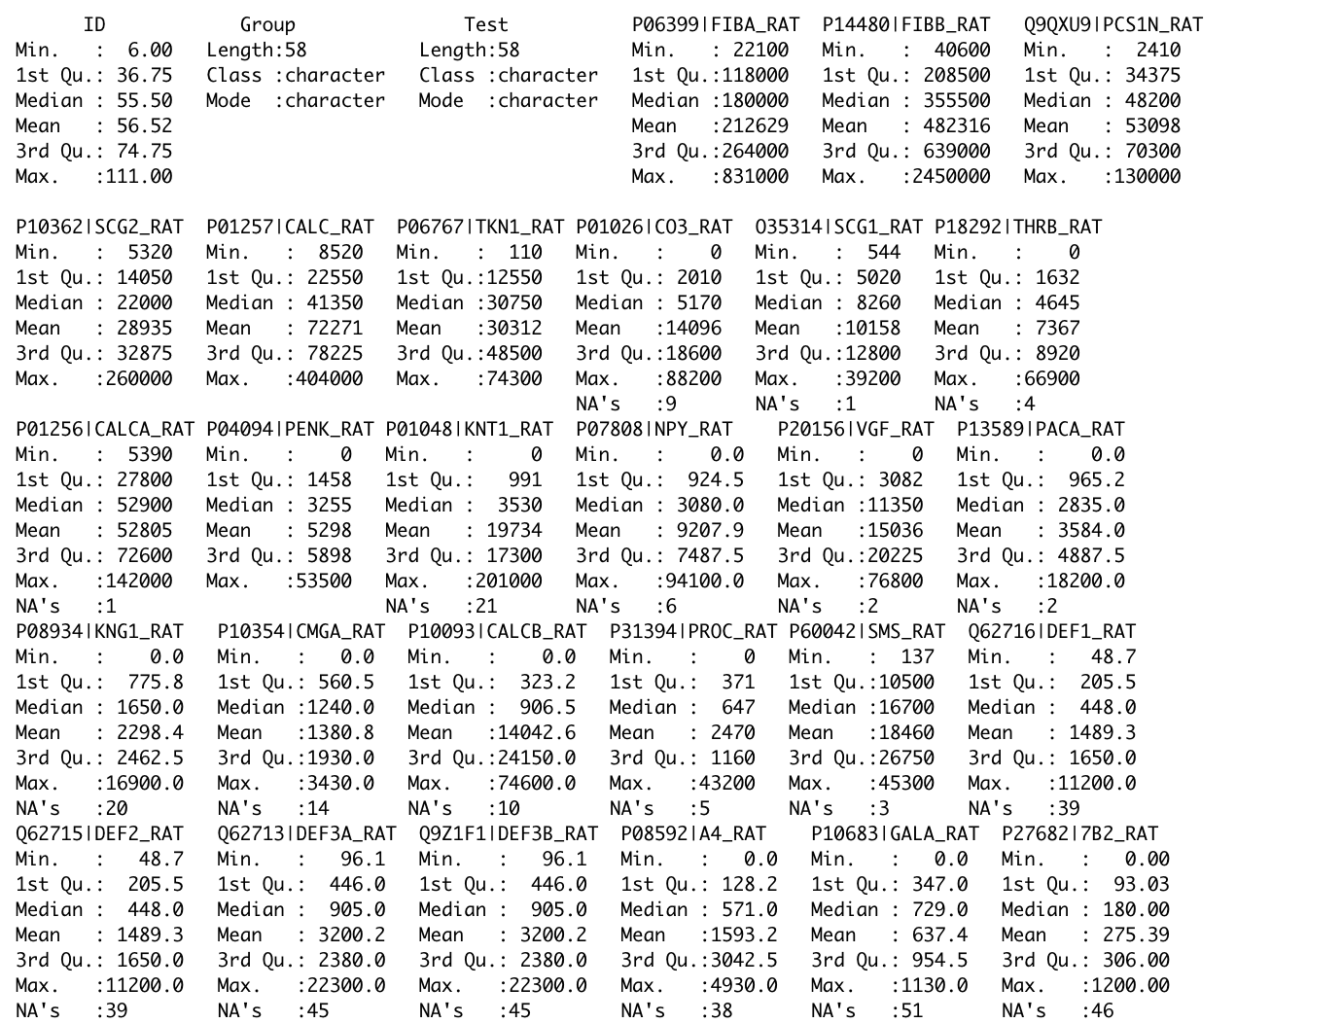

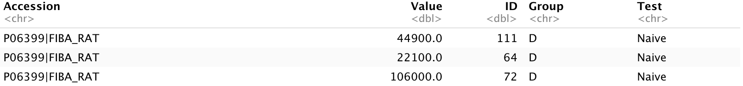
2.1Data Description

Slide 9
2.2 Correlation
COMPARE Protein-1 | COMPARE Protein-2 | Correlation Number
P06767|TKN1_RAT | Q9QXU9|PCS1N_RAT | 0.7734407
P06399|FIBA_RAT | P14480|FIBB_RAT | 0.9422568
Notes:
Before starting the test, we think that there might have some correlation between each protein, so that we test the correlation for each two protein, and find that there are three strong correlation (and at here we choose correlation value larger than 0.7)

Slide 10
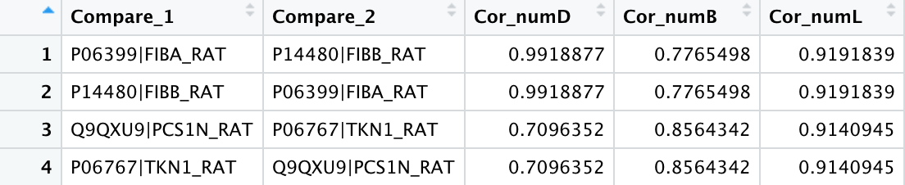
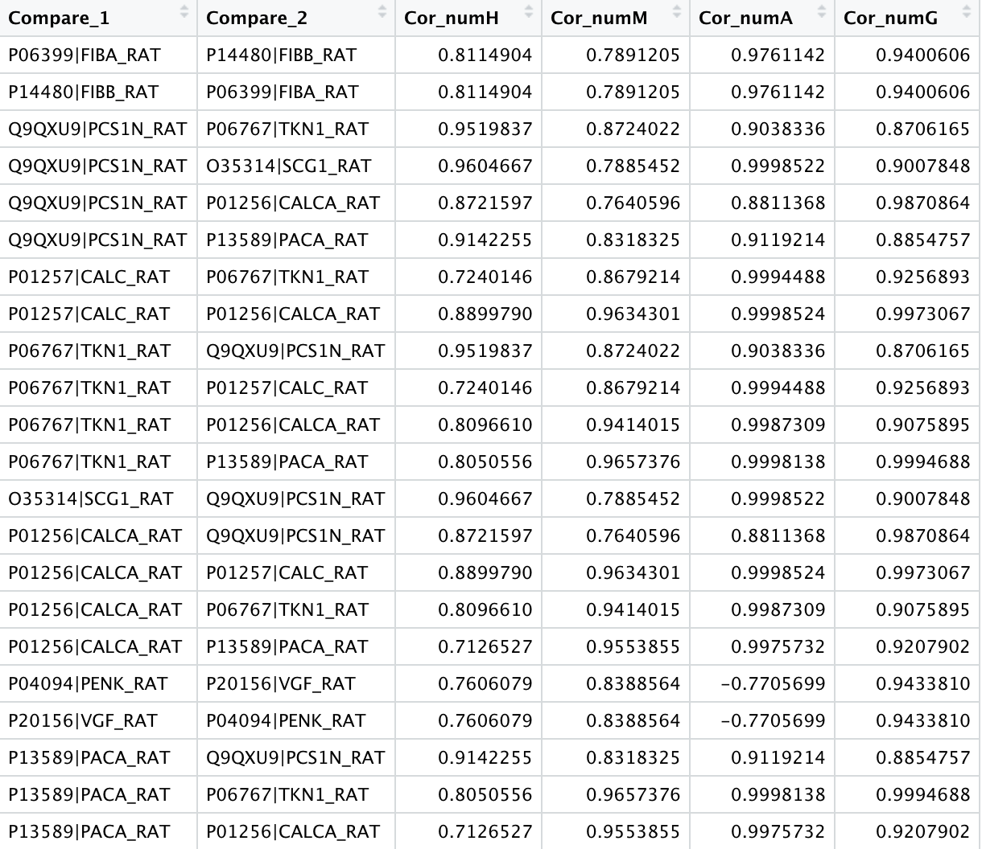

Slide 11
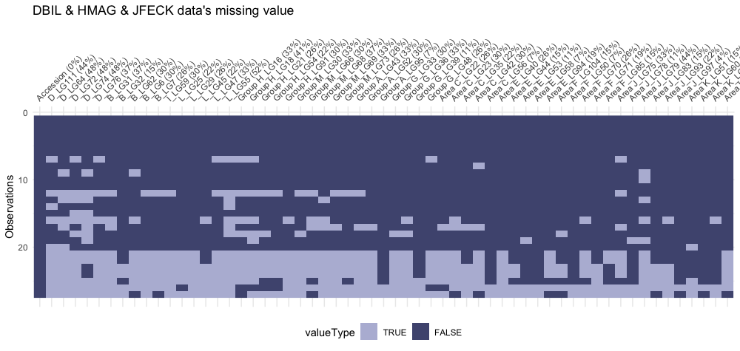
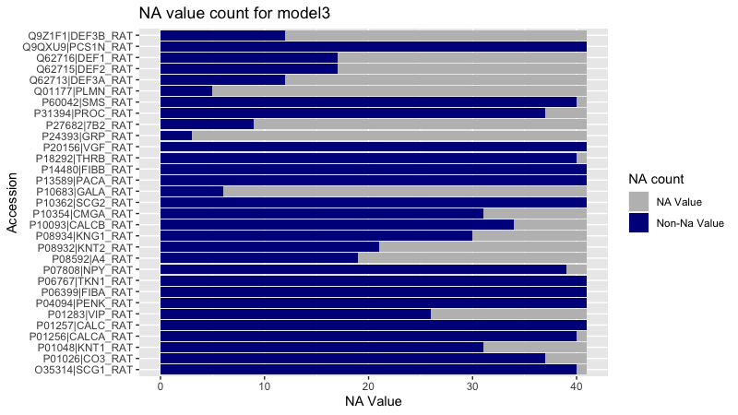
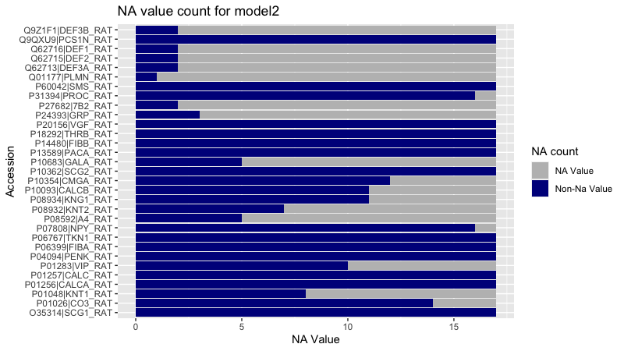
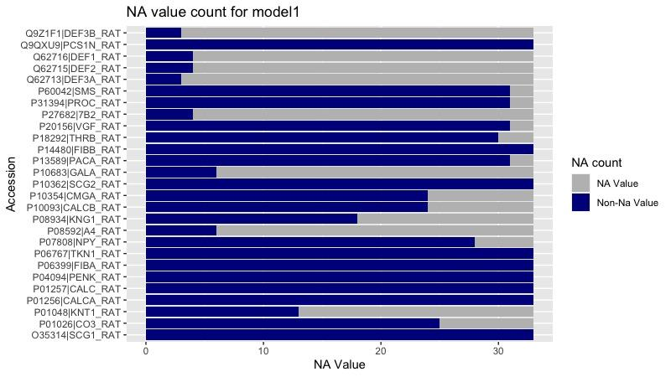
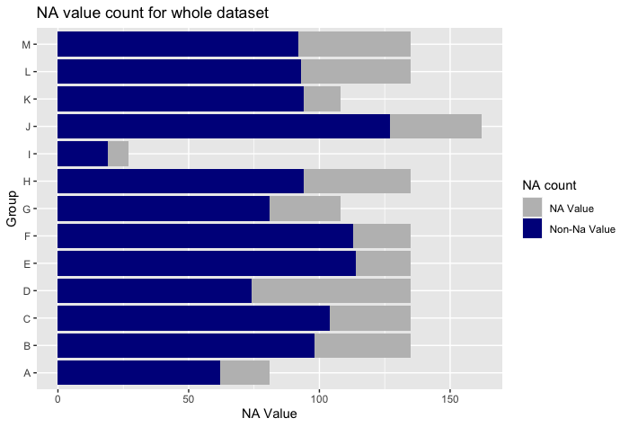
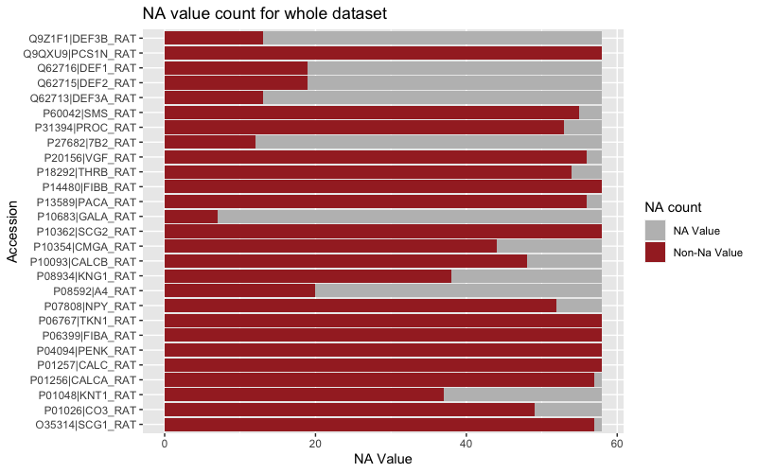
2.3 Missing Value
The total NA value in the whole dataset is 25.172%

Slide 12
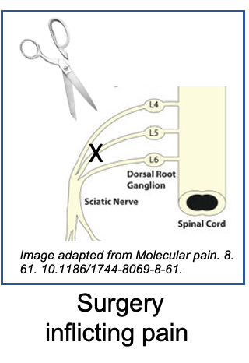
2.4 Missing Value from
There are two mainly reason:
Incorrect tissue collected
The amount protein is too small that cannot detection
Missing Value processing
Two Group Compare: remain each protein larger than 3 then delete
Multiple Group Compare: delete NA & remain

Slide 13
Analysis of variance Assumptions
Independence
Normality (Shapiro-Wilk test)
Homogeneity of variances (Bartlett's test)

Slide 14
D vs. H
P06399|FIBA_RAT
P14480|FIBB_RAT
Q9QXU9|PCS1N_RAT
P10362|SCG2_RAT
P01257|CALC_RAT
P06767|TKN1_RAT
P01256|CALCA_RAT
P10354|CMGA_RAT
P60042|SMS_RAT
B vs. M
P06399|FIBA_RAT
Q9QXU9|PCS1N_RAT
P10362|SCG2_RAT
P01257|CALC_RAT
P06767|TKN1_RAT
P01026|CO3_RAT
O35314|SCG1_RAT
P04094|PENK_RAT
P13589|PACA_RAT
P10093|CALCB_RAT
P60042|SMS_RAT
P18292|THRB_RAT
P08934|KNG1_RAT
L vs. G
P06399|FIBA_RAT
P14480|FIBB_RAT
Q9QXU9|PCS1N_RAT
P10362|SCG2_RAT
O35314|SCG1_RAT
P18292|THRB_RAT
P31394|PROC_RAT
P60042|SMS_RAT
P01048|KNT1_RAT
P07808|NPY_RAT
P20156|VGF_RAT
P08934|KNG1_RAT
P10354|CMGA_RAT

Slide 15
H vs. M vs. A vs. G
P06399|FIBA_RAT
P10362|SCG2_RAT
Q9QXU9|PCS1N_RAT
P18292|THRB_RAT
P60042|SMS_RAT

Slide 16
H vs. J
P06399|FIBA_RAT
P01257|CALC_RAT
P10362|SCG2_RAT
Q9QXU9|PCS1N_RAT
P06767|TKN1_RAT
P18292|THRB_RAT
P07808|NPY_RAT
P13589|PACA_RAT
P60042|SMS_RAT
P31394|PROC_RAT
M vs. F
P06399|FIBA_RAT
P20156|VGF_RAT
P06767|TKN1_RAT
P18292|THRB_RAT
P01026|CO3_RAT
P01256|CALCA_RAT
O35314|SCG1_RAT
P04094|PENK_RAT
P13589|PACA_RAT
P60042|SMS_RAT
P07808|NPY_RAT
P08934|KNG1_RAT
A vs. E
P01257|CALC_RAT
P10362|SCG2_RAT
Q9QXU9|PCS1N_RAT
P20156|VGF_RAT
P06767|TKN1_RAT
P07808|NPY_RAT
O35314|SCG1_RAT
P13589|PACA_RAT
P31394|PROC_RAT
P60042|SMS_RAT
G vs. C
P06399|FIBA_RAT
P01257|CALC_RAT
P10362|SCG2_RAT
Q9QXU9|PCS1N_RAT
P07808|NPY_RAT
P01256|CALCA_RAT
O35314|SCG1_RAT
P60042|SMS_RAT

Slide 17
K vs. E
P14480|FIBB_RAT
P06399|FIBA_RAT
P01257|CALC_RAT
P10362|SCG2_RAT
Q9QXU9|PCS1N_RAT
P01256|CALCA_RAT
P06767|TKN1_RAT
P10093|CALCB_RAT
O35314|SCG1_RAT
P10354|CMGA_RAT
P31394|PROC_RAT
P01283|VIP_RAT
P60042|SMS_RAT
K vs. C
P14480|FIBB_RAT
P06399|FIBA_RAT
P01048|KNT1_RAT
P01257|CALC_RAT
P10362|SCG2_RAT
Q9QXU9|PCS1N_RAT
P01256|CALCA_RAT
P06767|TKN1_RAT
P10093|CALCB_RAT
O35314|SCG1_RAT
P60042|SMS_RAT
K vs. E vs. C
P14480|FIBB_RAT
P06399|FIBA_RAT
P10362|SCG2_RAT
Q9QXU9|PCS1N_RAT
P01256|CALCA_RAT
P06767|TKN1_RAT
P10093|CALCB_RAT
O35314|SCG1_RAT
P60042|SMS_RAT

Slide 18
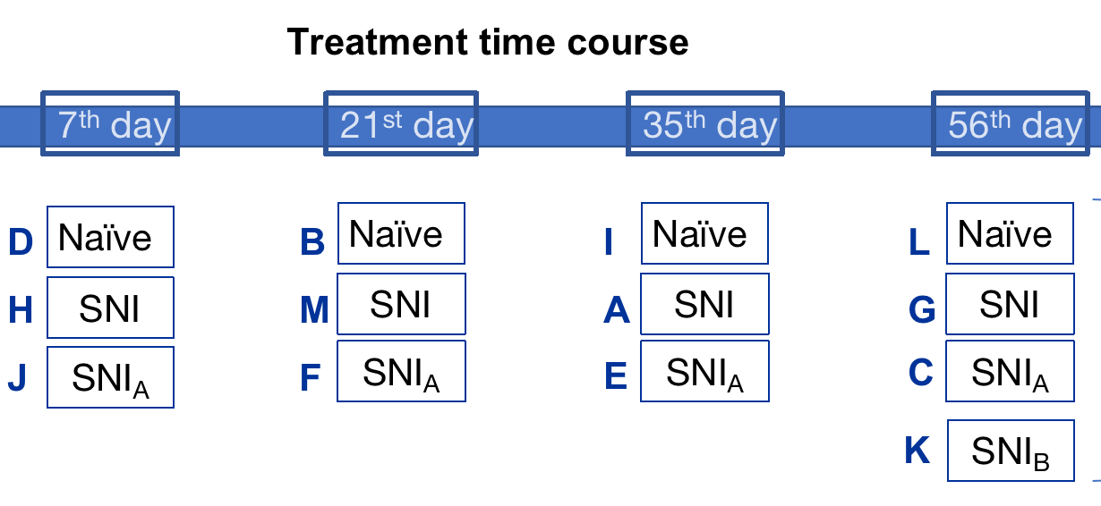
Test 1: Naive vs SNI at the same time course
D vs H
B vs M
I vs A
L vs G

Slide 19
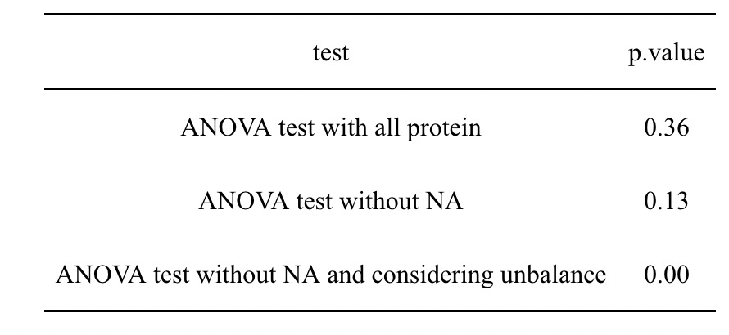
Test 1: Naive vs SNI at the same time course
D vs H

Slide 20
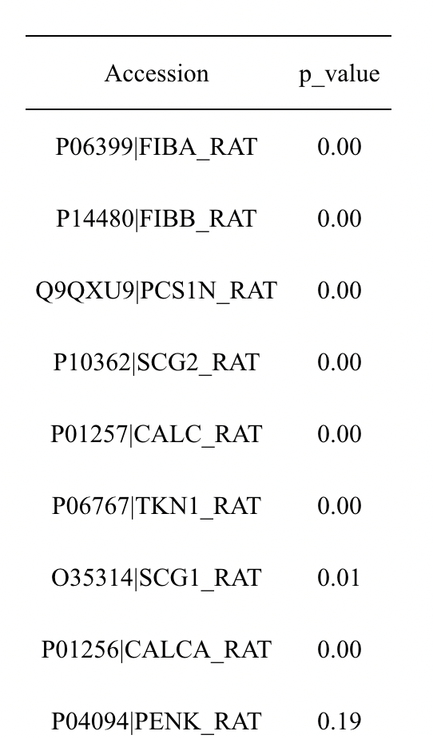
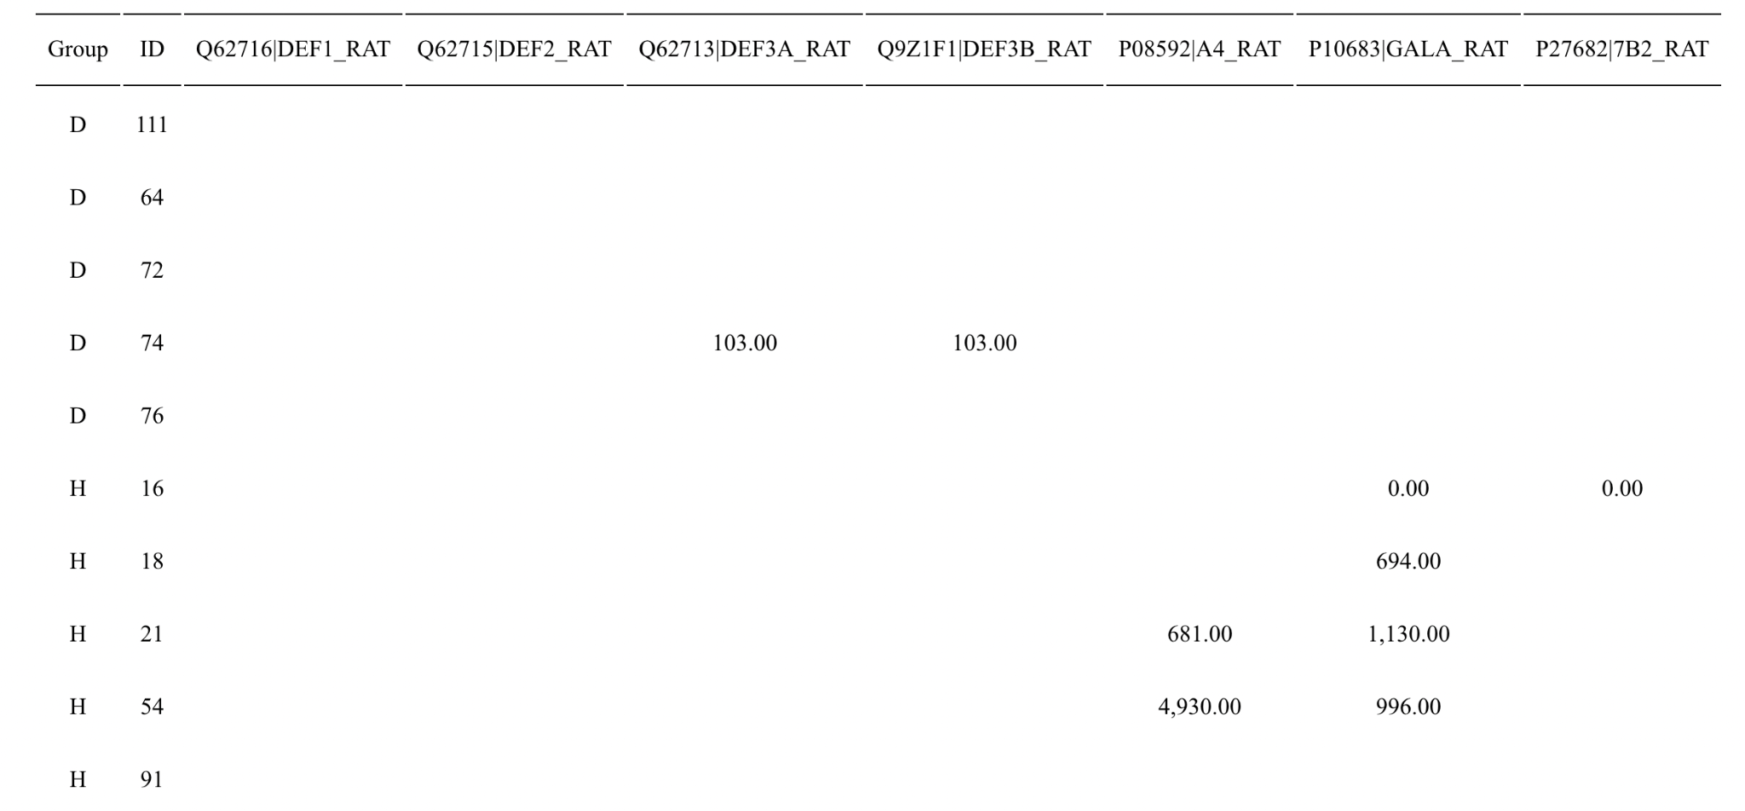
Protein without NA
Protein with NA

Slide 21
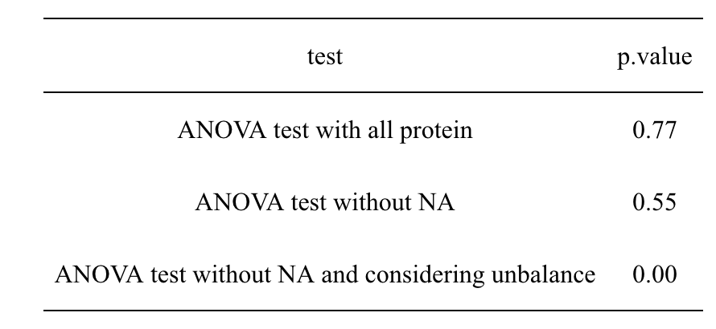
Test 1: Naive vs SNI at the same time course
B vs M
Notes:
Table: B v.s. M

Slide 22
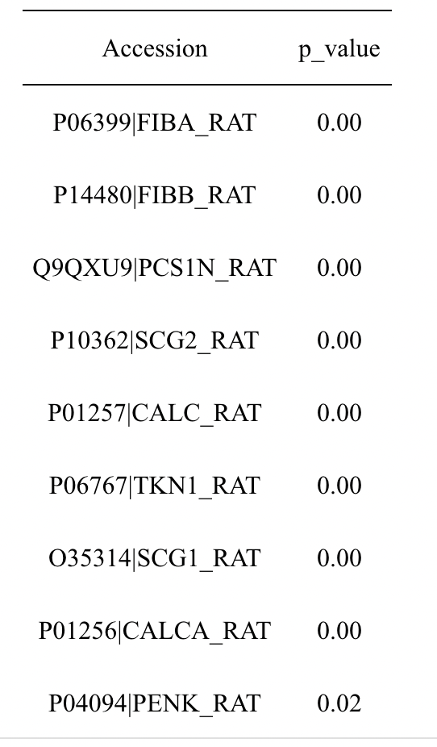
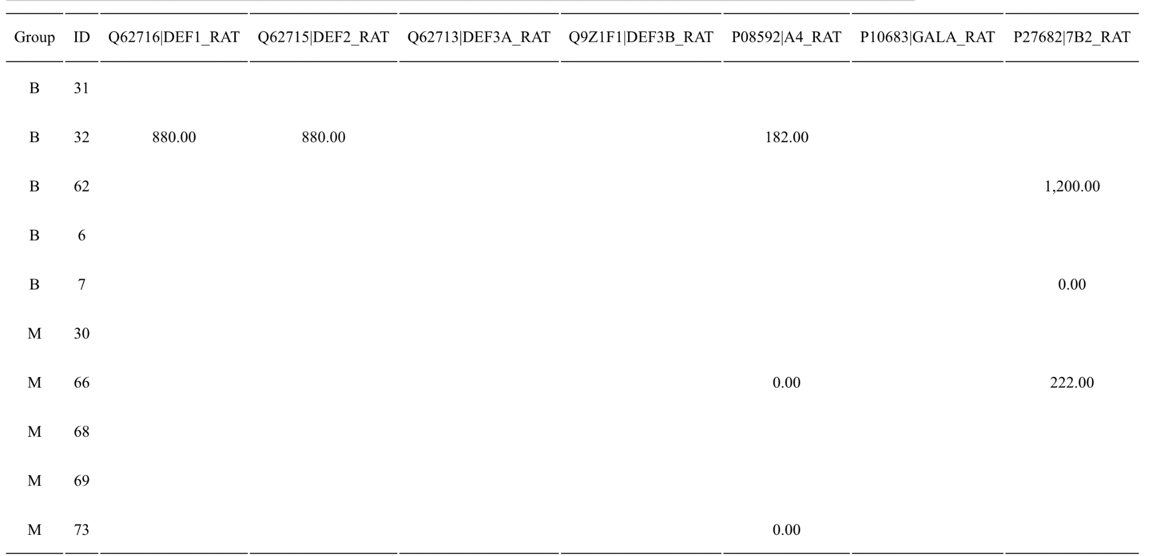
Protein without NA
Protein with NA

Slide 23
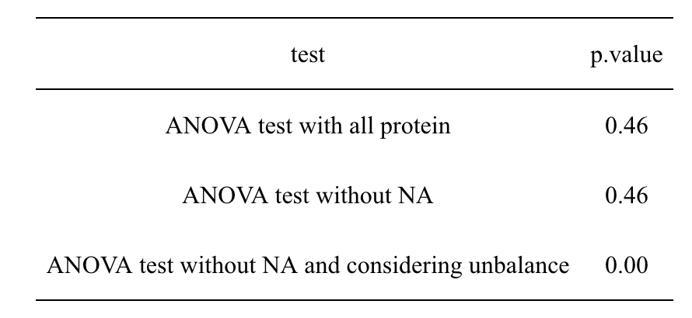
Test 1: Naive vs SNI at the same time course
I vs A

Slide 24
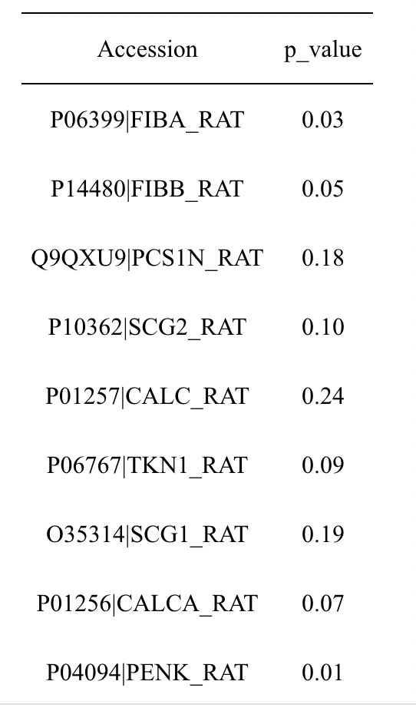
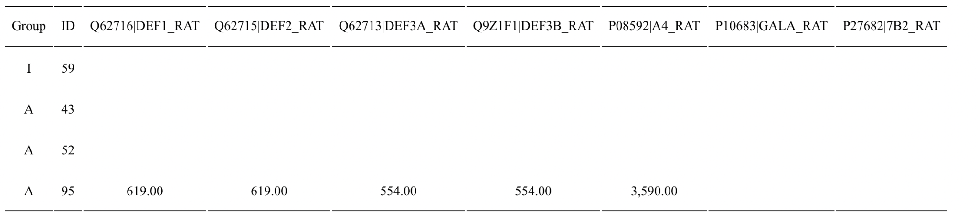
Protein without NA
Protein with NA

Slide 25
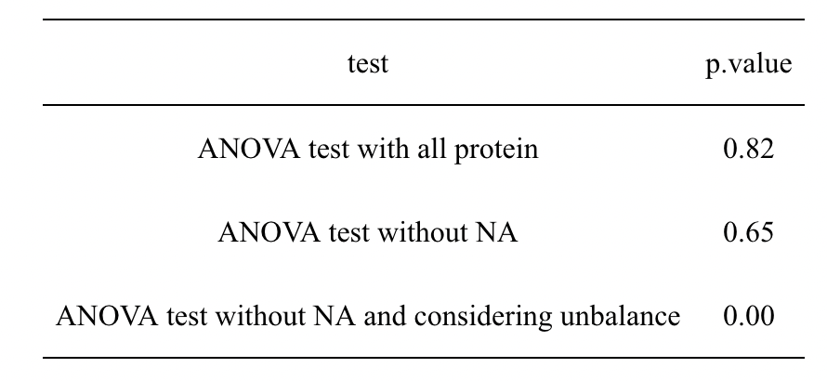
Test 1: Naive vs SNI at the same time course
L vs G

Slide 26
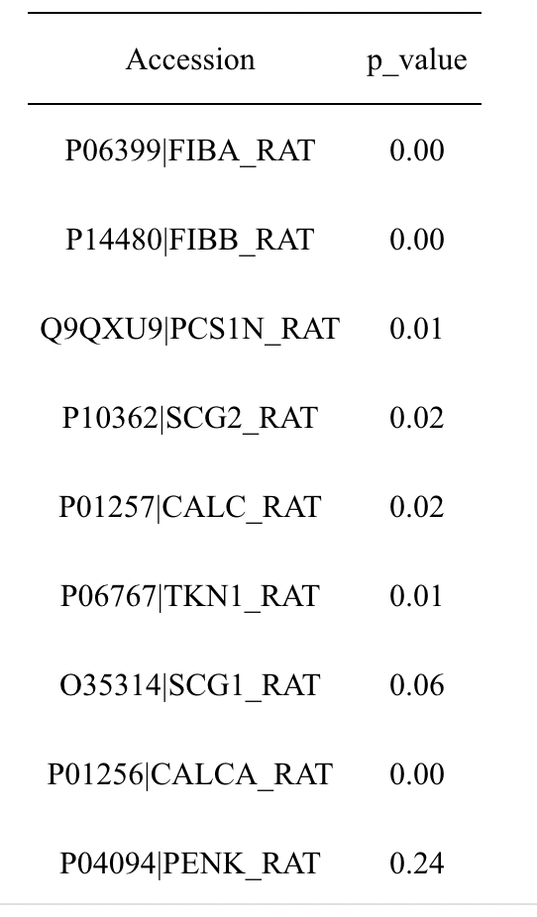
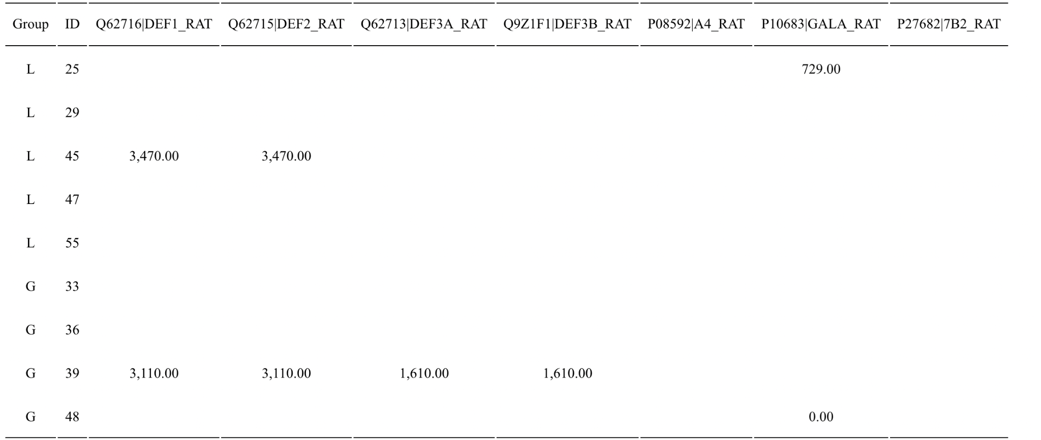
Protein without NA
Protein with NA

Slide 27
Test 2: SNI at
different time course
 |  | p-value
 | G-A | 0.9994
 | H-A | 0.8418
 | M-A | 0.9621
 | H-G | 0.7330
 | M-G | 0.9131
 | M-H | 0.9819
 | G-A | 0.9989
 | H-A | 0.7434
 | M-A | 0.8511
 | H-G | 0.5860
 | M-G | 0.7239
 | M-H | 0.9954
ANOVA test with all protein
ANOVA test without NA
ANOVA test without NA and considering unbalance: 1.410129e-14

Slide 28
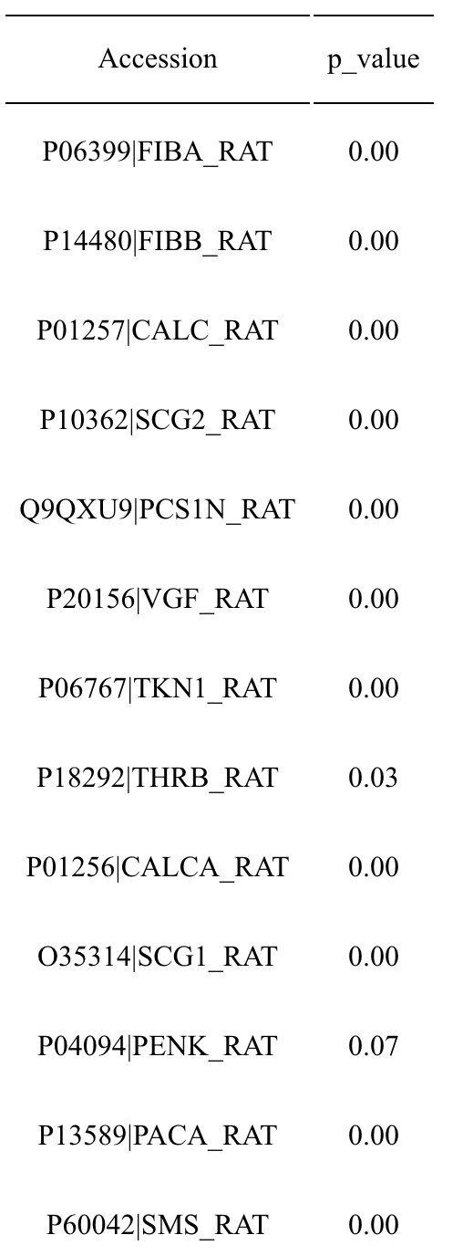
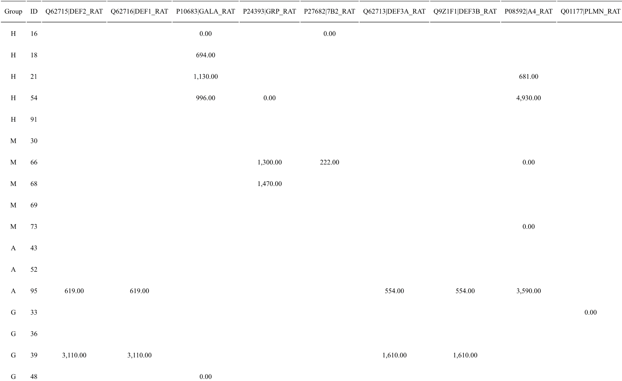
Protein without NA
Protein with NA

Slide 29
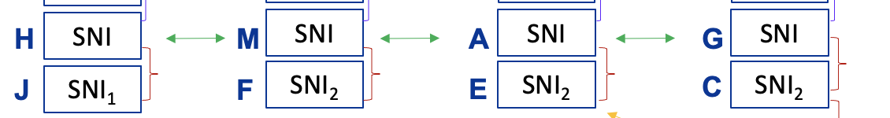
Test 3: SNI vs SNI_A at different time course
H vs J
M vs F
A vs E
G vs C

Slide 30
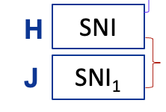
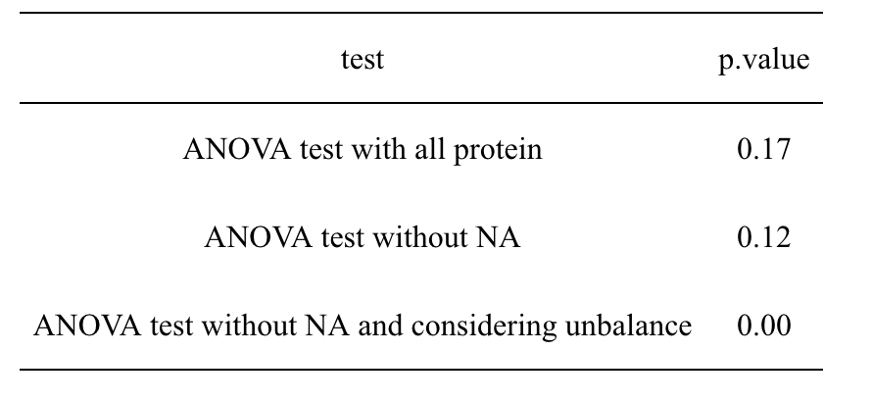
Test 3: SNI vs SNI at the same time course
H vs J

Slide 31
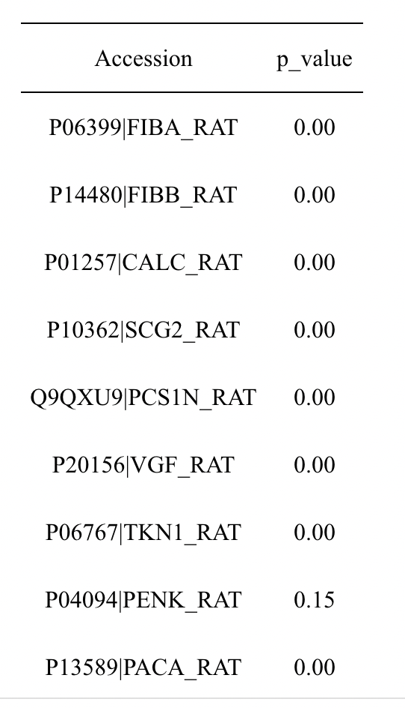
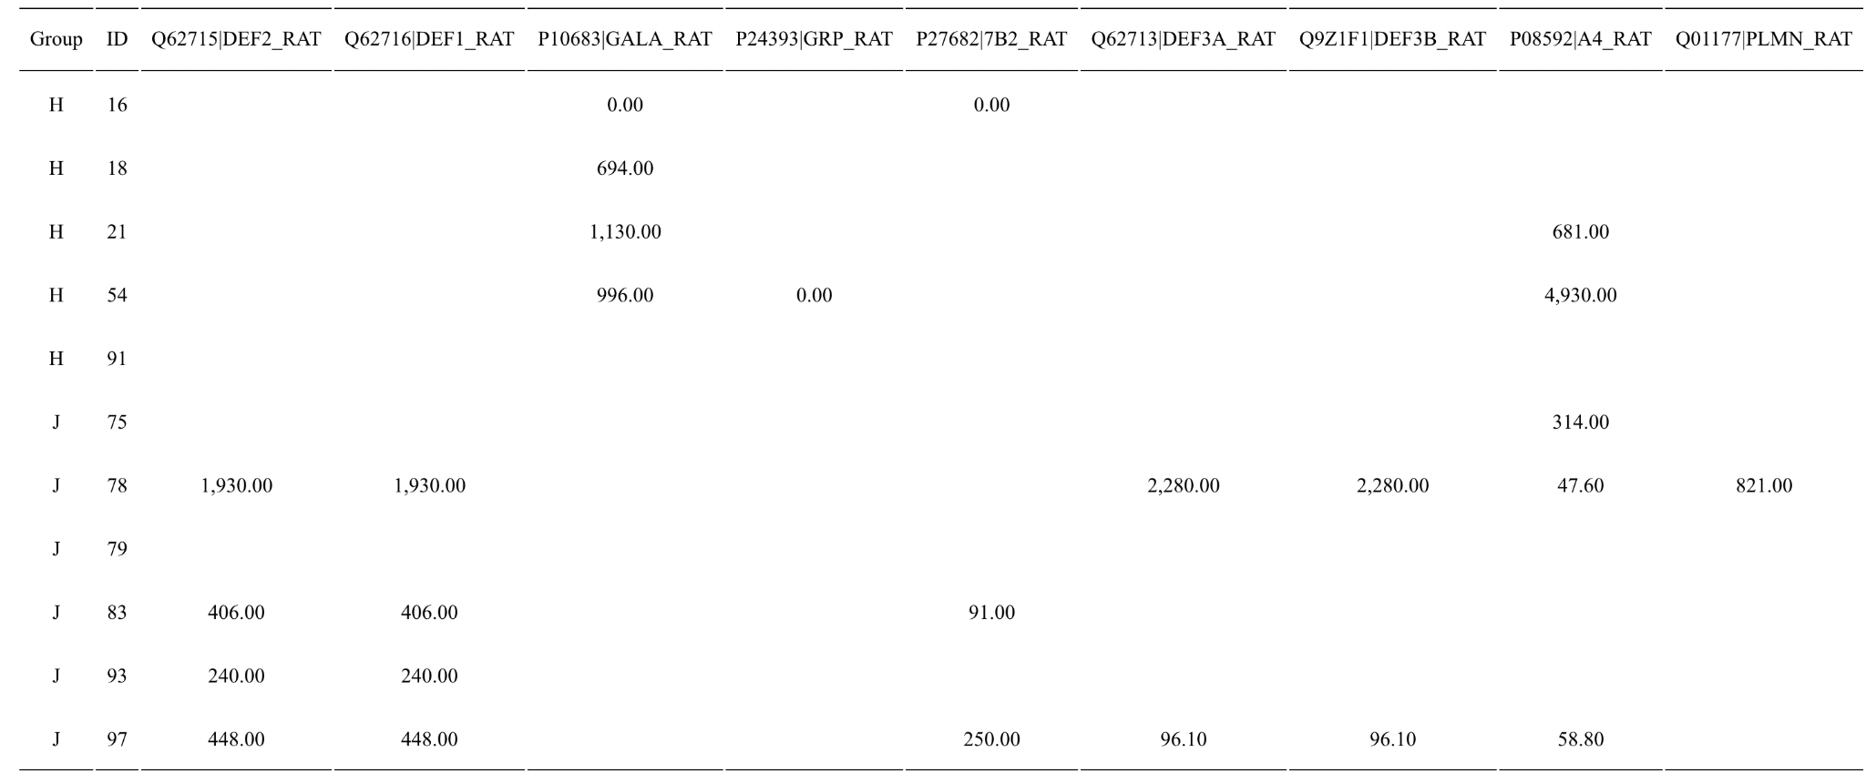
Protein without NA
Protein with NA

Slide 32
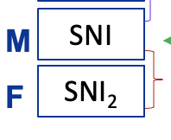

Test 3: SNI vs SNI at the same time course
M vs F

Slide 33
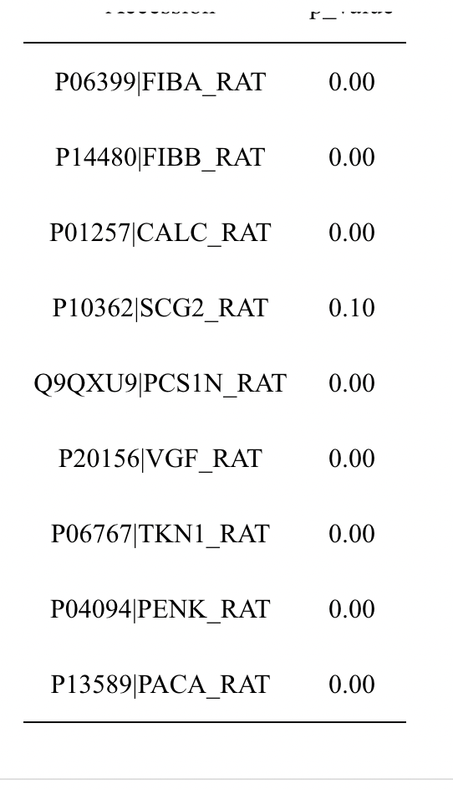
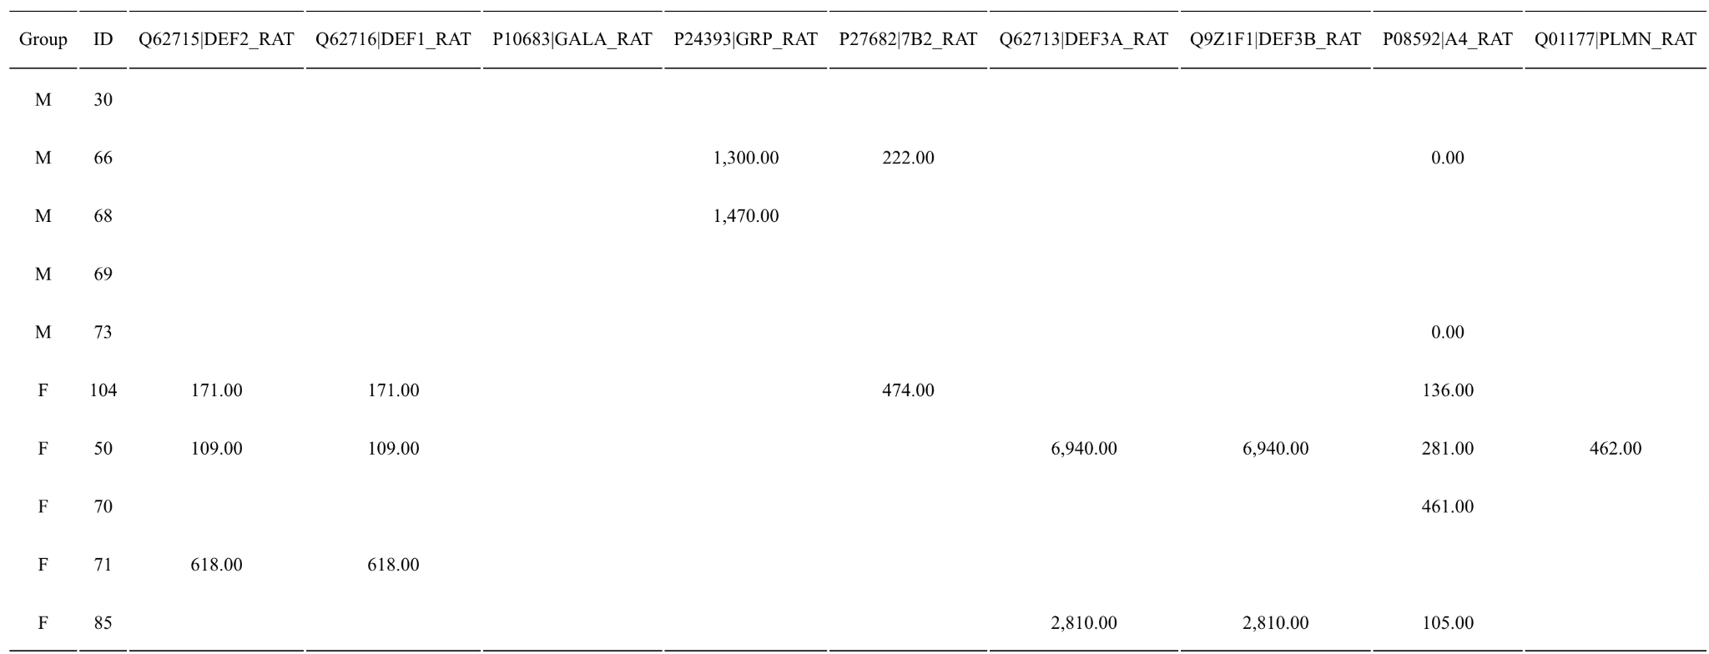
Protein without NA
Protein with NA

Slide 34
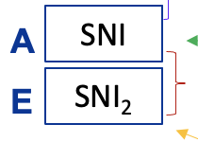

Test 3: SNI vs SNI at the same time course
A vs E

Slide 35
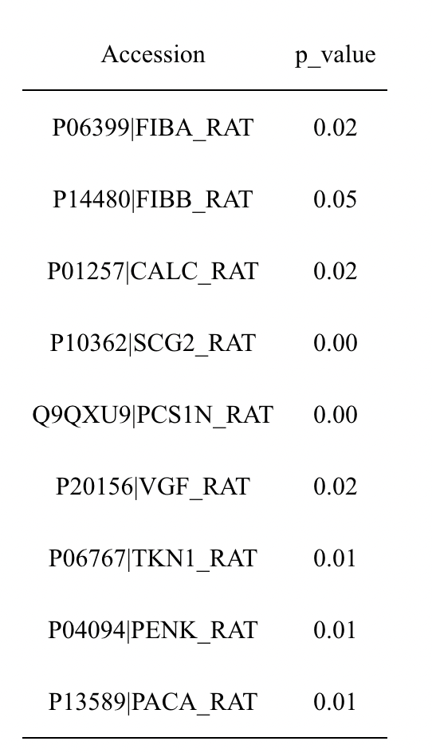
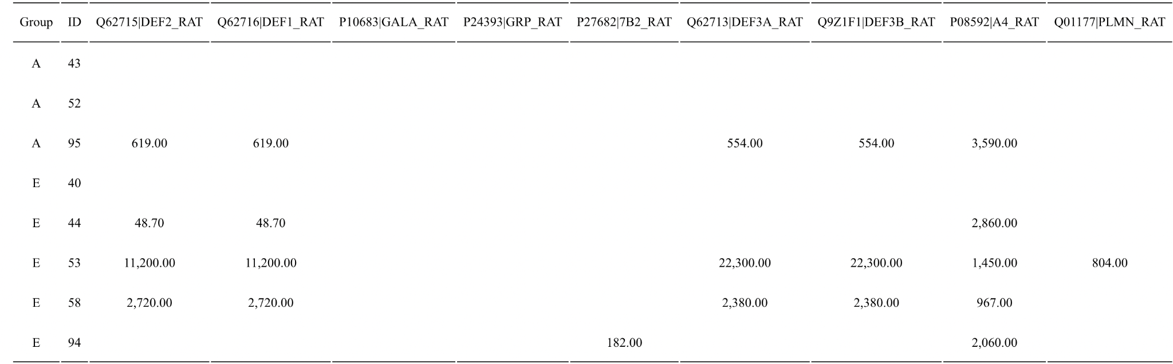
Protein without NA
Protein with NA

Slide 36
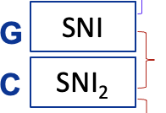

Test 3: SNI vs SNI at the same time course
C vs G

Slide 37
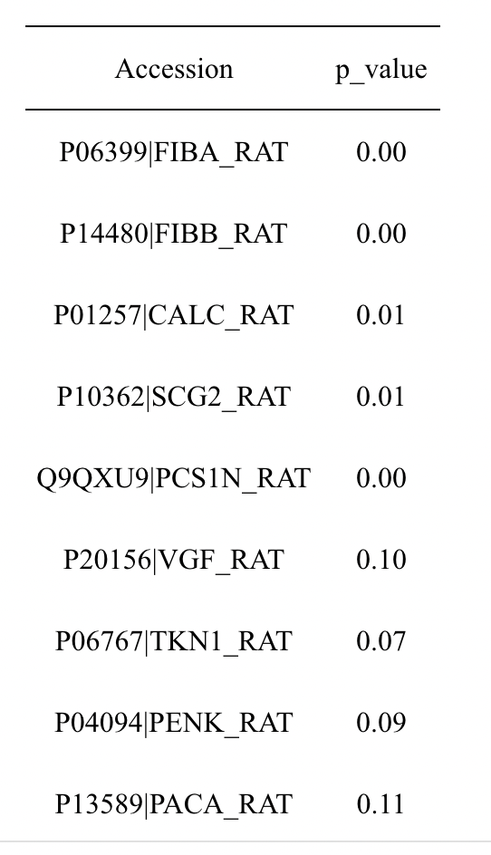
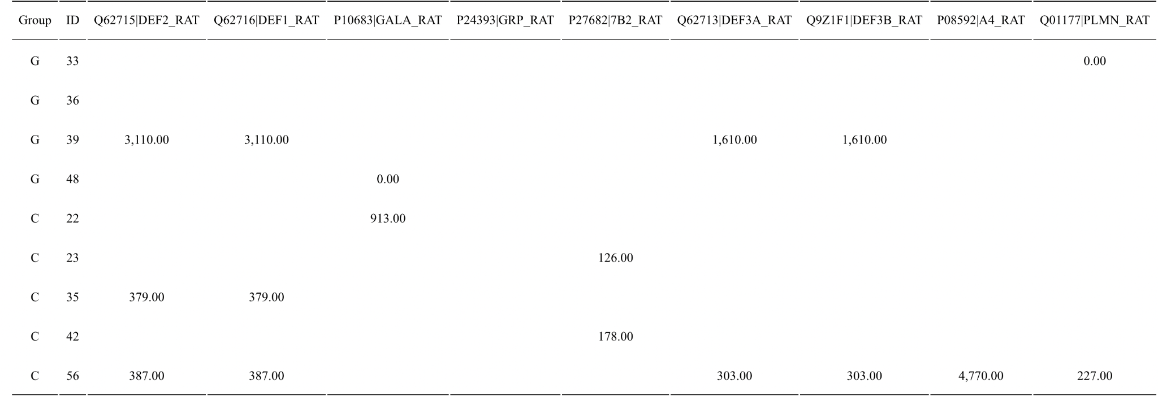
Protein without NA
Protein with NA

Slide 38
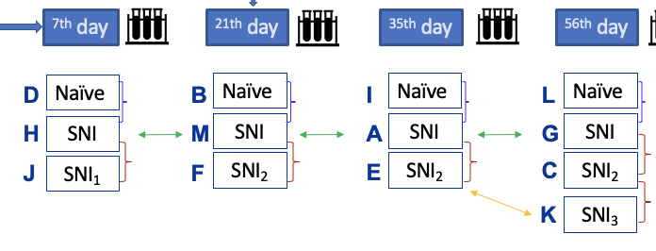
Test 4: Naive vs SNI vs (SNI_1 / SNI_2 / SNI_3) at same time course
D vs H vs J
B vs M vs F
I vs A vs E
L vs G vs C vs K
K vs E and K vs C

Slide 39
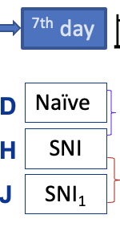
Test 4: Naive vs SNI vs SNI_A at different time course
D vs H vs J
 | Group | P value
 | H-D | 0.8891
 | J-D | 0.1618
 | J-H | 0.3224
 | H-D | 0.8422
 | J-D | 0.0315 (<0.05)
 | J-H | 0.1230
 |  | 5.5775e-08 (<0.05)
ANOVA test with all protein
ANOVA test without NA
ANOVA test without NA and considering unbalance
Table: D v.s. H v.s. J

Slide 40
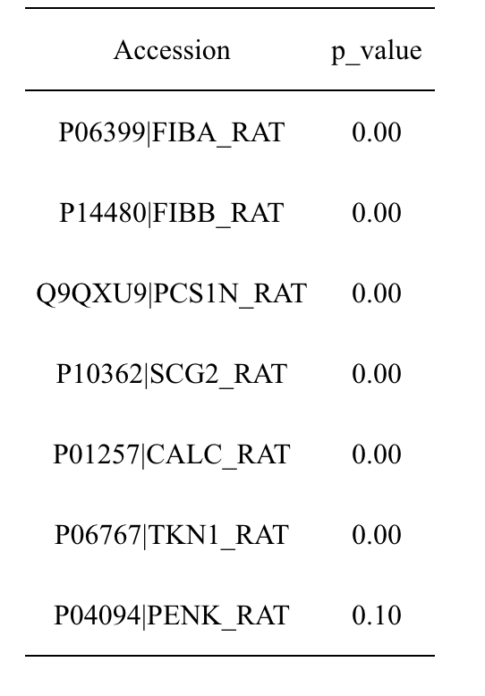

Protein without NA
Protein with NA

Slide 41

Test 4: Naive vs SNI vs SNI_A at different time course
B vs M vs F
 | Group | P value
 | F-B | 0.1830
 | M-B | 0.9825
 | M-F | 0.1346
 | F-B | 0.0595
 | M-B | 0.9529
 | M-F | 0.0285 (<0.05)
 |  | 1.688e-08 (<0.05)
ANOVA test with all protein
ANOVA test without NA
ANOVA test without NA and considering unbalance
Table: B v.s. M v.s. F

Slide 42


Protein without NA
Protein with NA

Slide 43

Test 4: Naive vs SNI vs SNI_A at different time course
I vs A vs E
 | Group | P value
 | E-A | 0.2569
 | I-A | 0.9457
 | I-E | 0.7817
 | E-A | 0.2379
 | I-A | 0.9463
 | I-E | 0.7300
 |  | 4.491e-04
ANOVA test with all protein
ANOVA test without NA
ANOVA test without NA and considering unbalance
Table: I v.s. A v.s. E
Notes:
表没改

Slide 44


Protein without NA
Protein with NA

Slide 45

 |  | p-value
 | G-C | 0.8227
 | K-C | 0.9513
 | L-C | 0.7175
 | K-G | 0.5349
 | L-G | 0.9989
 | L-K | 0.4114
 | G-C | 0.7983
 | K-C | 0.7763
 | L-C | 0.5776
 | K-G | 0.2930
 | L-G | 0.9911
 | L-K | 0.1409
Test 4: Naive vs SNI vs SNI_A at different
time course
L vs G vs C vs K
ANOVA test with all protein
ANOVA test without NA
ANOVA test without NA and considering unbalance: 1.4435e-06 (<0.05
Table: L vs G vs C vs K
Notes:
表没改

Slide 46


Protein without NA
Protein with NA

Slide 47

Test 4: K vs E and K vs C ( Additional)
 | Group | P value
 | E-C | 0.4668
 | K-C | 0.9360
 | K-E | 0.7074
 | E-C | 0.4543
 | K-C | 0.8285
 | K-E | 0.8470
 |  | 1.443e-06
ANOVA test with all protein
ANOVA test without NA
ANOVA test without NA and considering unbalance
Table: K vs E vs C
Notes:
表没改

Slide 48


Protein without NA
Protein with NA

Slide 49


Conclusion
Each group comparison having statistically significant differences!
There are statistically significant changes in proteins in DRGs (which stands for the Diagnosis-Related Group) that are associated with injury-induced or neuropathic pain and various treatment by local electrical stimulation.

Slide 50
Difficulties & Future Improvements
Difficulties:
Deal with missing values and empty columns.
Hard to find an appropriate model fit the data best.
Hard to determine the proper x and y values in our ANOVA model.
Future Improvements:
ANOVA-simultaneous component analysis (ASCA) - a tool to improve correlated problems.
Post Hoc Tests with ANOVA - determine which groups are significantly different from each other.
The Effect Size - understand the practical significance of the difference.

Slide 51
Thanks！

